Slide 1
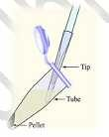
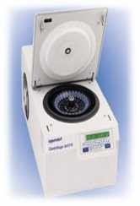
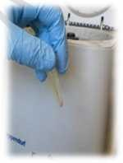
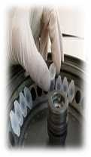
1
( Practical Molecular Biology
)
20 8 20 9
ؤ
1 -
1
ac R
lac.Raghad Ibrahim
l
.
Materials
TE buffer
10% sodium dodecyl sulfate (SDS)
20 mg/ml proteinase K (stored in small single-use aliquots at −20°C)
5 M NaCl
CTAB/NaCl solution
24:1 chloroform/isoamyl alcohol
25:24:1 phenol/chloroform/isoamyl alcohol (UNIT 2.1) Isopropanol
70% ethanol
1. Inoculate a 5-ml liquid culture with the bacterial strain of interest. Grow in
conditions appropriate for that strain (i.e., appropriate medium, drug selection, temperature) until the culture is saturated. This may take several hours to several days, depending on the growth rate.
2. Spin 1.5 ml of the culture in a microcentrifuge for 2 min, or un
forms. Discard the supernatant.
l a compact pellet
3. Resuspend pellet in 567 µl TE buﬀer by repeated pipe ng. Add 30 µl of 10% SDS
and 3 µl of 20 mg/ml proteinase K to give a ﬁnal concentra on of 100 µg/ml

Slide 2
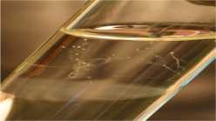
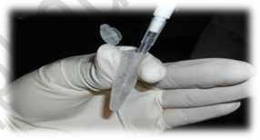
2
( Practical Molecular Biology
)
20 8 20 9
ؤ
1 -
1
ac R
lac.Raghad Ibrahim
l
.
proteinase K in 0.5% SDS. Mix thoroughly and incubate 1 hr at 37°C. The solution
should become viscous as the detergent lyses the bacterial cell walls. There should be no need to predigest the bacterial cell wall with lysozyme.
4. Add 100 µl of 5 M NaCl and mix thoroughly.
This step is very important since a CTAB–nucleic acid precipitate will form if salt concentra on drops below about 0.5 M at room
The aim here is to remove cell wall debris, denatured protein, and polysaccharides complexed to CTAB, while retaining the nucleic acids in solution.
5. Add 80 µl of CTAB/NaCl solu on. Mix thoroughly and incubate 10 min at 65°C.
6. Add an approximately equal volume (0.7 to 0.8 ml) of chloroform/isoamyl alcohol,
mix thoroughly, and spin 4 to 5 min in a microcentrifuge.
This extraction removes CTAB–protein/polysaccharide complexes. A white interface should be visible after centrifugation.
7. Remove aqueous, viscous supernatant to a fresh microcentrifuge tube, leaving the
interface behind. Add an equal volume of phenol/chloroform/isoamyl alcohol, extract thoroughly, and spin in a microcentrifuge for 5 min.
With some bacterial strains the interface formed after chloroform extraction is not
compact enough to allow easy removal of the supernatant. In such cases, most of the interface can be fished out with a sterile toothpick before removal of any supernatant. Remaining CTAB precipitate is then removed in the phenol/chloroform extraction.
8. Transfer the supernatant to a fresh tube. Add 0.6 vol isopropanol to precipitate
the nucleic acids (there is no need to add salt since the NaCl concentration is already high). Shake the tube back and forth until a stringy white DNA precipitate becomes clearly visible. At this point it is possible to transfer the pellet to a fresh tube containing 70% ethanol by hooking it onto the end of a micropipet that has been heat-sealed and bent in a Bunsen flame. Alternatively, the precipitate can be pelleted by spinning briefly at room temperature.

Slide 3
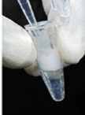
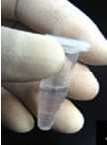
3
( Practical Molecular Biology
)
20 8 20 9
ؤ
1 -
1
ac R
lac.Raghad Ibrahim
l .
If no stringy DNA precipitate forms in the above step, this implies that the DNA has sheared into relatively low-molecular-weight pieces. If this is acceptable, i.e., if DNA is to be digested to completion with restriction endonucleases for Southern blot analysis, chromosomal DNA can often still be recovered simply by pelleting the precipitate in a microcentrifuge.
9. Wash the DNA with 70% ethanol to remove residual CTAB and respin 5 min at room
temperature to repellet it. Carefully remove the supernatant and briefly dry the pellet in a lyophilizer.
10. Redissolve the pellet in 100 mlTE buffer.
This may take some me (up to 1 hr) since the DNA is of high molecular weight.

